Slide 1

Robust End-to-end Model for Automatic Speech Recognition
presented by
Zhao Yingzhu
Supervisor
Assoc. Prof. Chng Eng Siong
10 July 2020

Slide 2
Outline
Introduction
What, why and hows of end-to-end automatic speech recognition (ASR)
Why are there robustness issues in ASR
Contributions
Cross Attention with Monotonic Alignment
Speaker Aware Persistent Memory
Conclusions & Future Work

Slide 3
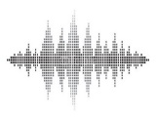
Introduction
What is end-to-end automatic speech recognition (ASR)?
Transform speech to its text transcription
End-to-end model ^{[1]}: directly map input acoustic features into output tokens (phonemes, characters, words, etc.)
Speech
Text
End-to-end
Model
…..................................
Speech
Text
Acoustic
Model
Pronunciation
Dictionary
Language
Model
…..................................
Word
Lattice
Hybrid DNN-HMM ASR ^{[2]}
[1] Jan Chorowski, et al. “End-to-end continuous speech recognition using attention-based recurrent NN: First results.” arXiv preprint, 2014.
[2] Geoffrey Hinton, et al. “Deep neural networks for acoustic modeling in speech recognition.” IEEE Signal Processing Magazine, 2012.

Slide 4
Introduction
Why do we need end-to-end ASR?
Learn the mapping holistically without error propagation from multiple pipelined components
Avoid using handcrafted features like pronunciation dictionary
Speech
Text
End-to-end
Model
…..................................
Speech
Text
Acoustic
Model
Pronunciation
Dictionary
Language
Model
…..................................
Word
Lattice
Hybrid DNN-HMM ASR ^{[1]}
[1] Geoffrey Hinton, et al. “Deep neural networks for acoustic modeling in speech recognition.” IEEE Signal Processing Magazine, 2012.

Slide 5
Introduction
How do end-to-end models perform ASR?
Connectionist Temporal Classification (CTC) ^{[1-5,13]}
Attention Encoder-Decoder (AED) ^{[6-9,13]}
Recurrent Neural Network Transducer (RNN-T) ^{[2,10,11]}
Speech Transformer ^{[12]}
[1] A. Graves, et al. “Connectionist temporal classification: labelling unsegmented sequence data with recurrent neural networks.” ICML, 2006.
[2] A. Graves, et al. “Speech recognition with deep recurrent neural networks.” ICASSP 2013.
[3] H. Soltau, et.al. “Neural Speech Recognizer: Acoustic-to-Word LSTM Model for Large Vocabulary Speech Recognition”, Interspeech 2016 [4] Y. Zhang, et al. “Towards End-to-End Speech Recognition with Deep Convolutional Neural Networks,” Interspeech, 2016.
[5] Audhkhasi et al. “Forget a Bit to Learn Better: Soft Forgetting for CTC-based Automatic Speech Recognition”, Interspeech 2019.
[6] J. Chorowski, et al. “Attention-based models for speech recognition,” NeurIPS 2015.
[7] W. Chan, et al. “Listen, attend and spell: A neural network for large vocabulary conversational speech recognition,” 2016 ICASSP.
[8] Y. Zhang, et al. “Very deep convolutional networks for end-to-end speech recognition,” ICASSP 2017.
[9] C. Chiu, “State-of-the-Art Speech Recognition with Sequence-to-Sequence Models”, ICASSP 2018.
[10] A. Graves, “Sequence Transduction with Recurrent Neural Networks,” CoRR, vol. abs/1211.3711, 2012.
[11] J. Li, et al. “Improving RNN transducer modeling for end-to-end speech recognition,” ASRU 2019.
[12] L. Dong, et al. “Speech-transformer: A no-recurrence sequence-to-sequence model for speech recognition,” ICASSP 2018.
[13] S. Kim et. al. “Joint CTC-attention based End-to-end speech recognition using multi-task learning”, ICASSP 2017.

Slide 6
Introduction
History of end-to-end ASR models
CTC | Graves 2006 (Uni Toronto) |  | Graves 2013 (Uni Toronto) |  | Soltau (Google) | Zhang (Uni. Montreal) |  | Audhkhasi (IBM)
AED |  |  |  | Chorowski (Uni. Montreal) | Chan (Google) | Zhang (Google) | Chiu (Google)
RNN-T |  | Graves 2012 (Uni Toronto) | Graves 2013 (Uni Toronto) |  |  |  |  | Li (Microsoft)
Trans-former |  |  |  |  |  |  | Dong (Uni. of Chinese Academy of Sciences)
CTC+AED |  |  |  |  |  | Kim (MERL)
 | 2006 | 2012 | 2013 | 2015 | 2016 | 2017 | 2018 | 2019
[] Reference at previous slide

Slide 7
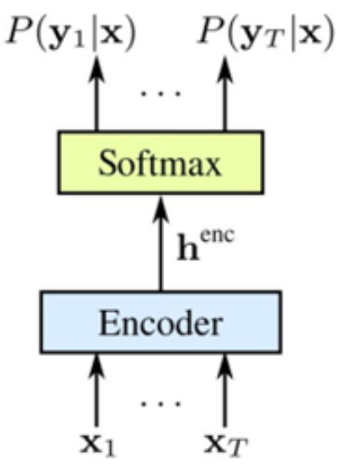
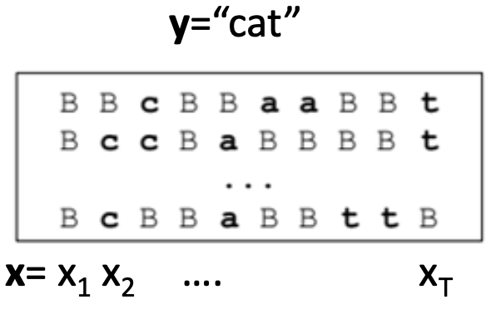
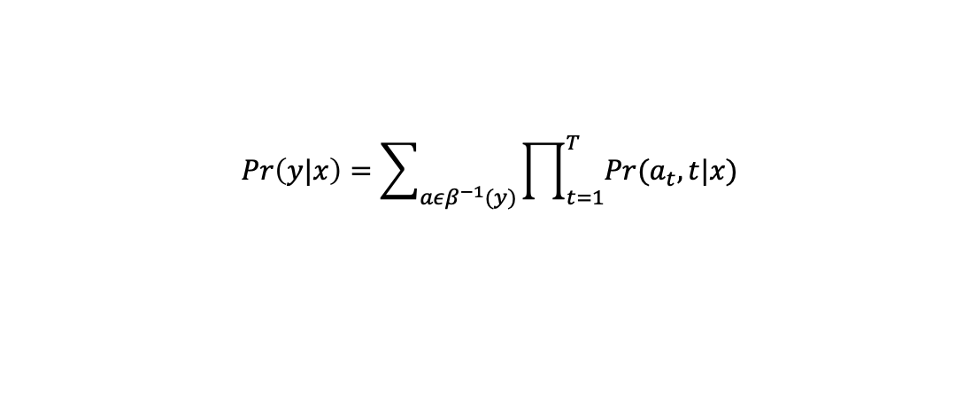

Introduction
How do end-to-end models perform ASR?
Connectionist Temporal Classification (CTC) ^{[1-3]}
A encoder structure with a softmax layer behind to make a label prediction for each time step
The final output probability is
$$Pr\left(k,t|x\right)=\frac{exp⁡(y_{t}^{k})}{\sum_{k^{′}}{\exp{(y_{t}^{k^{′}})}}}$$
$$Pr\left(y|x\right)=\sum_{aεβ^{−1}(y)}{\prod_{t=1}^{T}{Pr(a_{t},t|x)}}$$
[1] A. Graves, et al. “Connectionist temporal classification: labelling unsegmented sequence data with recurrent neural networks.” ICML, 2006.
[2] A. Graves, et al. “Speech recognition with deep recurrent neural networks.” ICASSP 2013.
[3] A. Graves and N. Jaitly. “Towards end-to-end speech recognition with recurrent neural networks.”, ICML 2014.

Slide 8
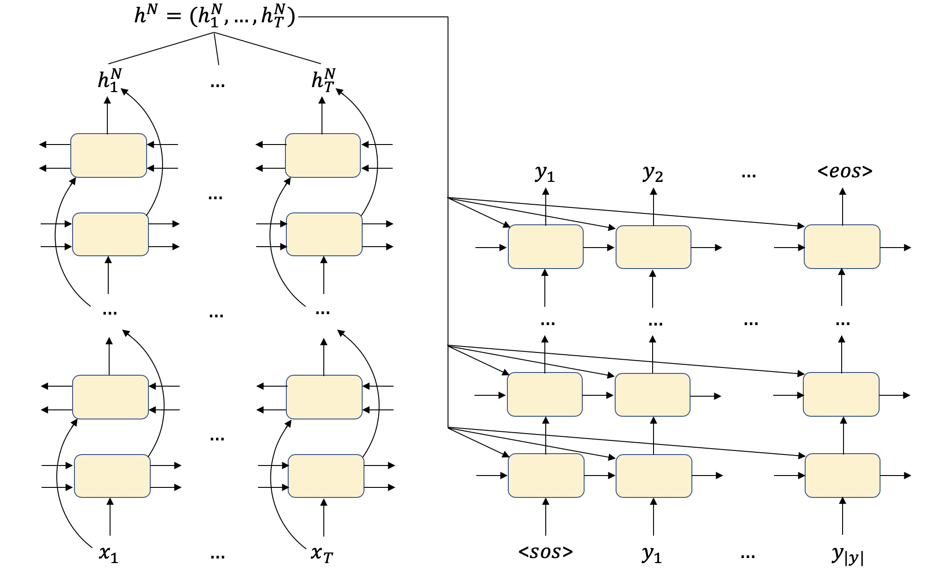


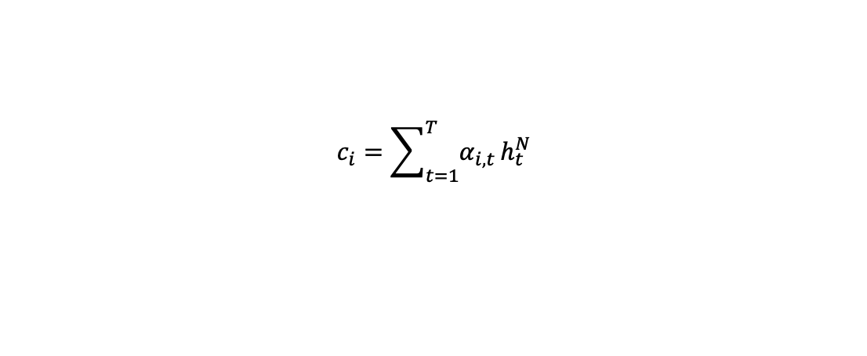
Introduction
How do end-to-end models perform ASR?
Attention Encoder-Decoder (AED) ^{[1-3]}
Both encoder and decoder deploy recurrent neural network (RNN)
The attention computation for context vector $c_{i}$
$$e_{i,t}=s_{i}W_{s}∗{(h_{t}^{N}W_{h})}^{T}$$
$$α_{i,t}=\frac{exp⁡(e_{i,t})}{\sum_{t=1}^{T}{exp⁡(e_{i,t})}}$$
$$c_{i}=\sum_{t=1}^{T}{α_{i,t}}h_{t}^{N}$$
[1] J. Chorowski, et al. “Attention-based models for speech recognition.” NIPS, 2015.
[2] W. Chan, et al. “Listen, attend and spell: A neural network for large vocabulary conversational speech recognition .” ICASSP 2016.
[3] Y. Zhang, et al. “Very deep convolutional networks for end-to-end speech recognition.”, ICASSP 2017.

Slide 9
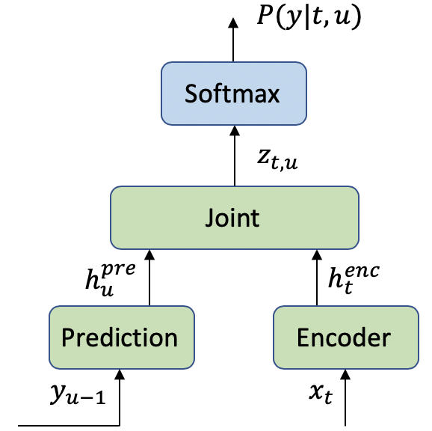
Introduction
How do end-to-end models perform ASR?
Recurrent Neural Network Transducer (RNN-T) ^{[1-2]}
A encoder network same as AED encoder
A prediction network that acts like language model
A joint network combines encoder and prediction network outputs
$$h_{t}^{enc}=f^{enc}(x_{t})$$
$$h_{u}^{pre}=f^{pre}(y_{u−1})$$
$$h_{t,u}=W_{y}ψ\left(Uh_{t}^{enc}+Vh_{u}^{pre}+b_{z}\right)+b_{y}$$
$$P(k|t,u)=softmax(h_{t,u}^{k})$$
[1] A. Graves, “Sequence Transduction with Recurrent Neural Networks,” CoRR, vol. abs/1211.3711, 2012.
[2] J. Li, R. Zhao, H. Hu, and Y. Gong, “Improving RNN transducer modeling for end-to-end speech recognition,” ASRU 2019.

Slide 10
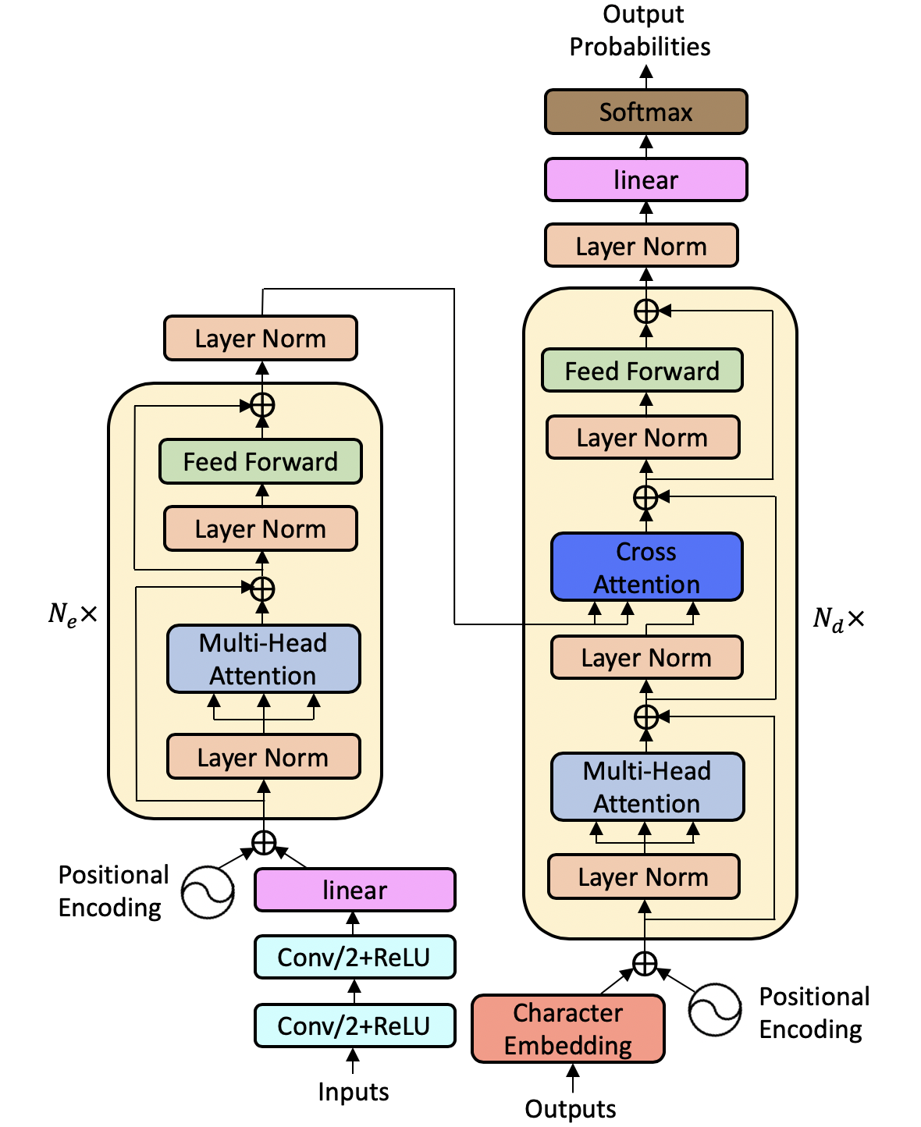
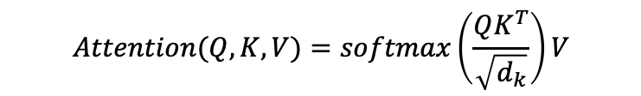
Introduction
How do end-to-end models perform ASR?
Speech Transformer ^{[1-2]}
Self-attention network
$$Attention(Q,K,V)=softmax\left(\frac{QK^{T}}{\sqrt{d_{k}}}\right)V$$
$${head}_{i}=Attention(QW_{i}^{Q},KW_{i}^{K},VW_{i}^{V})$$
$$MultiHead\left(Q,K,V\right)=Concat({head}_{1},…,{head}_{h})W^{O}$$
[1] A. Vaswani, et al. “Attention is all you need,” NeurIPS, 2017.
[2] L. Dong, S. Xu, and B. Xu, “Speech-transformer: A no-recurrence sequence-to-sequence model for speech recognition,” ICASSP 2018.

Slide 11
Introduction
Comparison of AED and Transformer
Dataset | Error | AED+CTC | Transformer+CTC
AISHELL | CER | 6.8 / 8.0 | 6.0 / 6.7
AURORA4 | WER | 3.5 / 6.4 / 5.1 / 12.3 | 3.3 / 6.0 / 4.5 / 10.6
CSJ | CER | 6.6 / 4.8 / 5.0 | 5.7 / 4.1 / 4.5
CHiME4 | WER | 9.5 / 8.9 / 18.3 / 16.6 | 9.6 / 8.2 / 15.7 / 14.5
CHiME5 | WER | 59.3 / 88.1 | 60.2 / 87.1
Fisher-CH Spanish | WER | 27.9 / 27.8 / 25.4 / 45.2 / 47.9 | 27.0 / 26.3 / 24.4 / 45.3 / 46.2
HKUST | CER | 27.4 | 23.5
JSUT | CER | 20.6 | 18.7
LibriSpeech | WER | 3.1 / 9.9 / 3.3 / 10.8 | 2.2 / 5.6 / 2.6 / 5.7
REVERB | WER | 24.1 / 27.2 | 15.5 / 19.0
SWBD | WER | 28.5 / 15.6 | 18.1 / 9.0
Ted-Lium2 | WER | 11.2 / 11.0 | 9.3 / 8.1
Ted-Lium3 | WER | 14.3 / 15.0 | 9.7 / 8.0
VoxForge | CER | 12.9 / 12.6 | 9.4 / 9.1
WSJ | WER | 7.0 / 7.4 | 6.8 / 4.4
[1] S. Karita, et.al. “A Comparative Study on Transformer vs RNN in Speech Applications”, ASRU 2019.

Slide 12
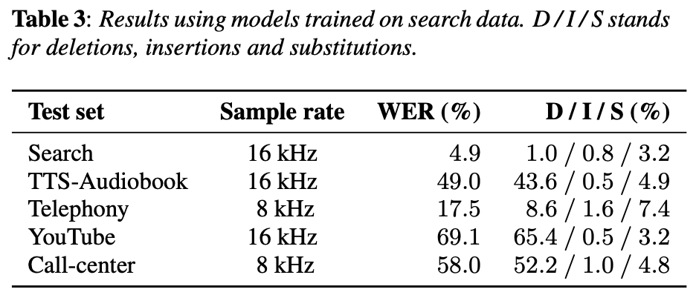
Introduction
Why is there robustness issues in ASR?
ASR is sensitive to the differences between training and test data
Noise
Speaker
Accent
Domain
Channel
A. Narayanan, et al. “Recognizing Long-form Speech Using Streaming End-to-end Models”, ASRU 2019.

Slide 13
C1: Cross Attention with Monotonic Alignment
2.1 Motivation
2.2 Model architecture
2.3 Experiments and results

Slide 14
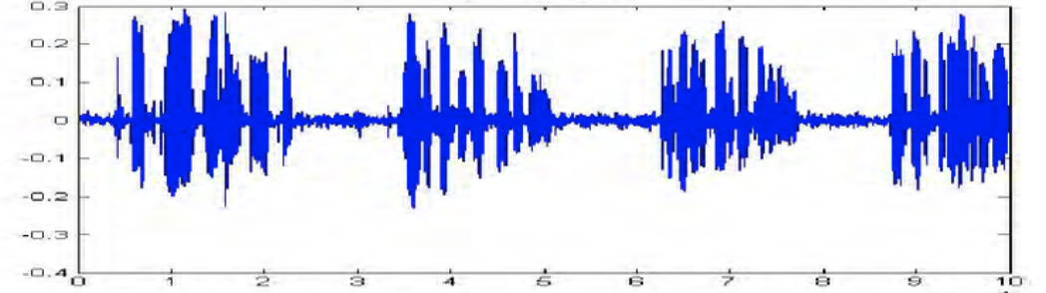
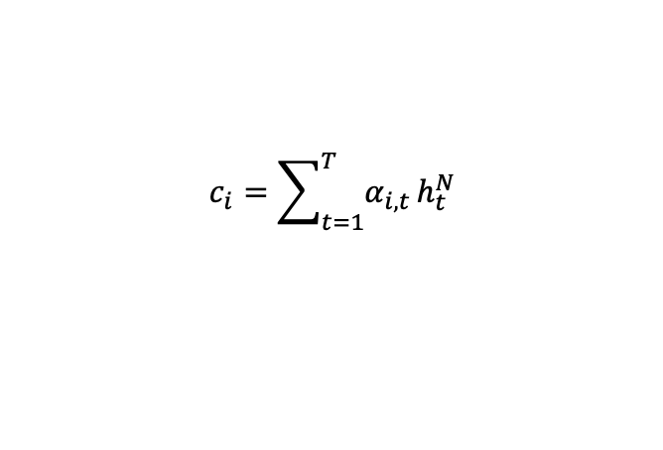
2.1 Motivation
For transformer model
Cross attention disperses the attention distribution over the entire speech input
In speech recognition
The text output and its speech input are monotonically aligned
$$c_{i}=\sum_{t=1}^{T}{α_{i,t}}h_{t}^{N}$$
align
One Two Three Four
One speech and its text transcription example.

Slide 15
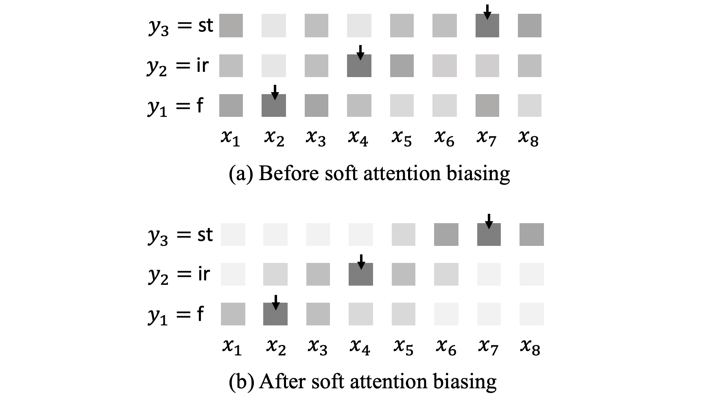
2.2 Model architecture
Cross attention
Alignment
Take the position with the maximum cross attention weight as the input alignment position
Cross attention biasing
Add a Gaussian mask centered at alignment position (soft alignment biasing)

Slide 16
2.2 Model architecture
Cross attention
Look-ahead frames ^{[1]}
Apply cross attention biasing at lower layers of the decoder ^{[2]}
Monotonic alignment regularization
[1] N. Moritz, T. Hori, and J. L. Roux, “Triggered attention for end-to-end speech recognition,” ICASSP 2019.
[2] A. Raganato and J. Tiedemann, “An analysis of encoder representations in transformer-based machine translation,” EMNLP 2018.

Slide 17
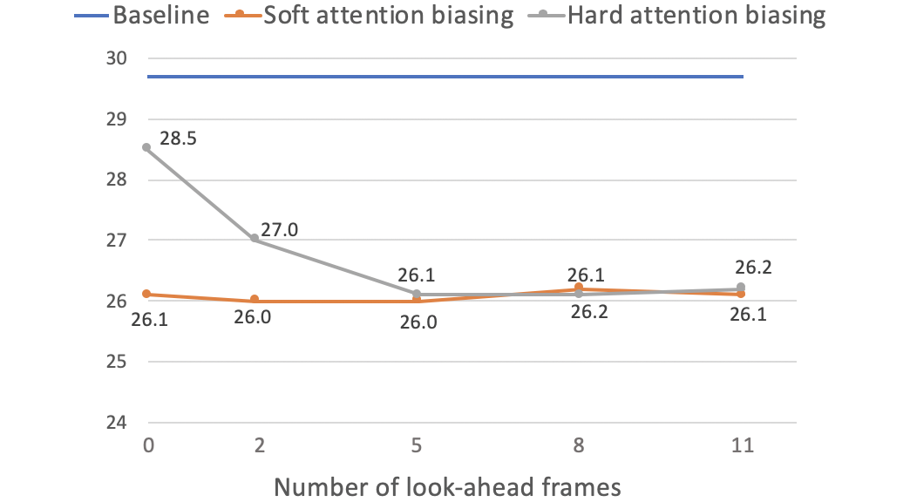
2.3 Experiment
Dataset
Number of look-ahead frames
LibriSpeech ^{[1]} | Length | Baseline WER
Training set | 100 hour | -
Test_clean set | 5.4 hour | 12.0
Test_other set | 5.1 hour | 29.7
Number of look-ahead frames does not affect soft attention biasing
Use 5 look-ahead frames with soft attention biasing
[1] V. Panayotov, G. Chen, D. Povey, and S. Khudanpur, “Librispeech: an ASR corpus based on public domain audio books,” ICASSP 2015.

Slide 18
2.3 Experiment
Number of decoder layers applying cross attention biasing
Cross attention biasing and alignment regularization
Decoder layers applied | Test_clean | Test_other
Baseline | 12.0 | 29.7
Layer 1-3 | 9.4 | 25.9
Layer 4-6 | 9.5 | 26.2
Layer 1-6 | 9.4 | 26.0
Model | Test_clean | Test_other
Baseline | 12.0 | 29.7
Our proposed method | 9.0 | 25.4
w/o look-ahead frames | 9.3 | 25.9
w/o apply on layer 1-3 | 9.4 | 26.0
w/o alignment regularization | 9.4 | 25.9
Hybrid global+local model ^{[1]} | 9.4 | 25.9
[1] M. Xu, D. F. Wong, B. Yang, Y. Zhang, and L. S. Chao, “Leveraging local and global patterns for self-attention networks,” ACL 2019.

Slide 19
C2: Speaker Aware Persistent Memory
3.1 Motivation
3.2 Model architecture
3.3 Experiments and results

Slide 20
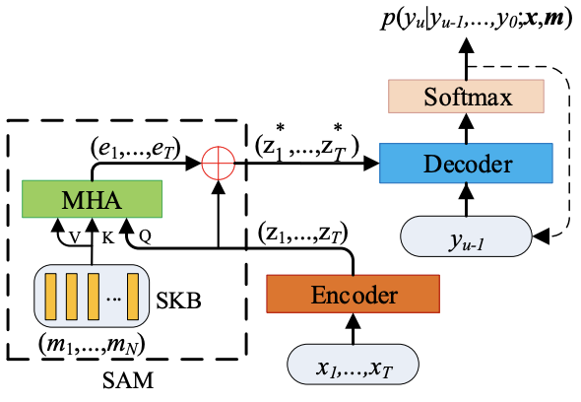

3.1 Motivation
Speaker adaptation
Add a multi-head attention network with speaker i-vectors after encoder ^{[1]}
$(e_{1},…,e_{T})$ are time step independent speaker representation
Double the parameter size of linear transformation in each decoder layer
[1] Z. Fan, J. Li, S. Zhou, and B. Xu, “Speaker-aware speech-transformer,” ASRU 2019.

Slide 21
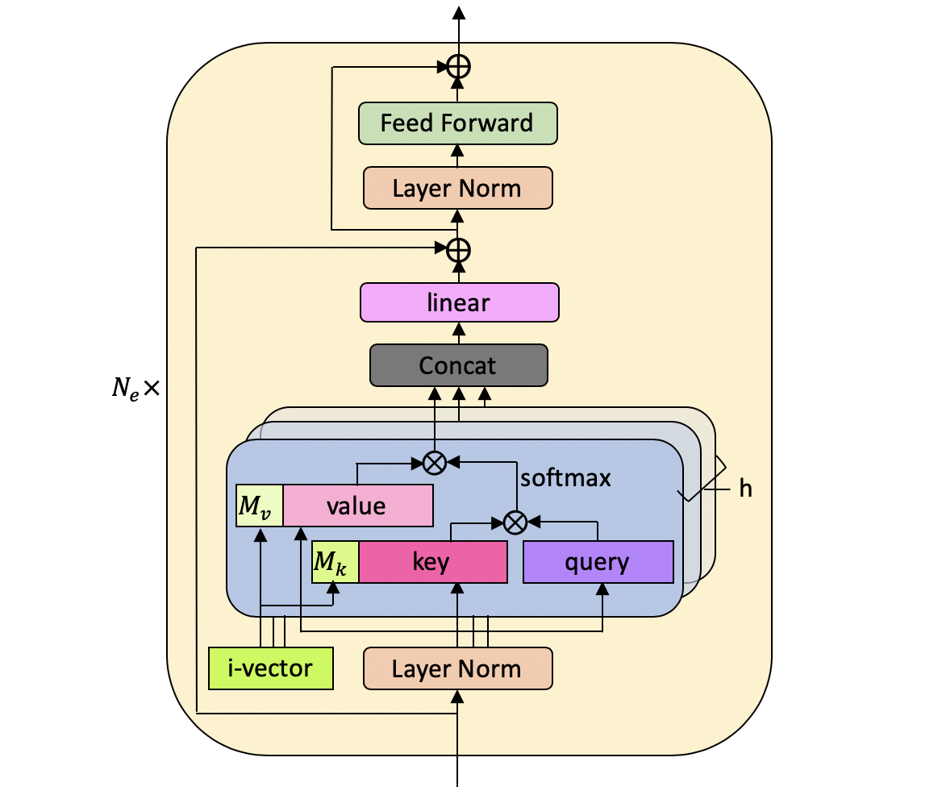
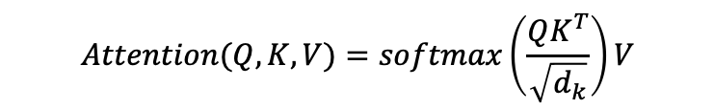

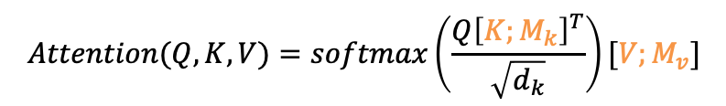
3.2 Model architecture
Speaker space
$N$ randomly sampled speaker i-vectors
$$m_{1},…,m_{N}∈ℝ^{d}$$
$$Attention(Q,K,V)=softmax\left(\frac{QK^{T}}{\sqrt{d_{k}}}\right)V$$
$$Attention(Q,K,V)=softmax\left(\frac{Q{\left[K;M_{k}\right]}^{T}}{\sqrt{d_{k}}}\right)[V;M_{v}]$$
encoder

Slide 22
3.3 Experiment
Dataset
LibriSpeech ^{[1]}
Training set | 100h (251 speakers)
Test_clean set | 5.4h (20 males, 20 females)
Test_other set | 5.1h (16 males, 17 females)
Switchboard ^{[2]}
Training set | 300h (4804 speakers)
SWBDset | 2.1h (40 speakers)
CallHome set | 1.6h (40 speakers)
AISHELL-1 ^{[3]}
Training set | 150h (340 speakers)
Test set | 5h (13 males, 7 females)
[1] V. Panayotov, G. Chen, D. Povey, and S. Khudanpur, “Librispeech: an ASR corpus based on public domain audio books,” ICASSP 2015.
[2] J. J. Godfrey, E. C. Holliman, and J. McDaniel, “SWITCHBOARD: telephone speech corpus for research and de- velopment,” ICASSP 1992.
[3] H. Bu, J. Du, X. Na, B. Wu, and H. Zheng, “AISHELL-1: An open-source mandarin speech corpus and a speech recognition baseline,” in 2017 20th O-COCOSDA. IEEE, 2017.

Slide 23
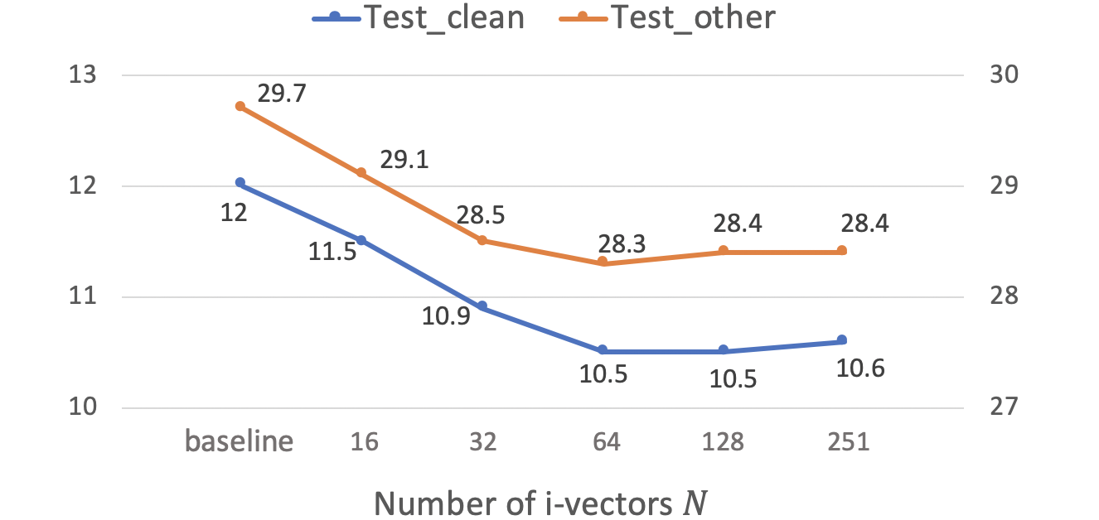
3.3 Experiment
Number of speaker i-vectors
Number of layers applied with speaker aware persistent memory
Performance improve from 16 to 64 i-vectors
After 64 i-vectors, increasing the number does not improve further
Encoder layers applied | Test_clean | Test_other
Baseline | 12.0 | 29.7
Lower half (1-6) | 11.2 | 28.6
Higher half (7-12) | 10.9 | 28.1
All (1-12) | 10.5 | 28.3
Applying on higher layers obtains better performance

Slide 24
3.3 Experiment
Comparison with other models
Model | Switchboard
 | SWBD | CallHome |  | All
Baseline | 8.8 | 18.0 |  | 13.4
Attn based ^{[1]} | - | - |  | 15.5
BLHUC ^{[2]} | 12.8 | 22.9 |  | -
PM ^{[3]} | 8.8 | 17.5 |  | 13.2
Our work | 8.2 | 16.0 |  | 12.1
Model | AISHELL-1
 | Dev |  | Test
Baseline | 6.4 |  | 7.3
SAST ^{[4]} | 7.6 |  | 7.8
PM ^{[3]} | 6.3 |  | 7.1
Our work | 5.9 |  | 6.4
Model | LibriSpeech
 | Test_clean |  | Test_other
Baseline | 12.0 |  | 29.7
SAST ^{[4]} | 11.4 |  | 28.4
PM ^{[3]} | 11.3 |  | 28.9
Our work | 10.5 |  | 28.3
Switchboard – 9.7% relative improvement
AISHELL-1 – 7.8%-12.3% relative improvement
LibriSpeech – 4.7%-12.5% relative improvement
[1] J. Pan, et al, “Online speaker adaptation for LVCSR based on attention mechanism,” APSIPA ASC, 2018. .
[2] X. Xie, et al, “BLHUC: Bayesian learning of hidden unit contributions for deep neural network speaker adaptation,” ICASSP 2019.
[3] Z. You, et al, “DFSMN-SAN with persistent memory model for automatic speech recognition,” arXiv preprint arXiv:1910.13282, 2019.
[4] Z. Fan, et al, “Speaker-aware speech-transformer,” ASRU 2019.

Slide 25
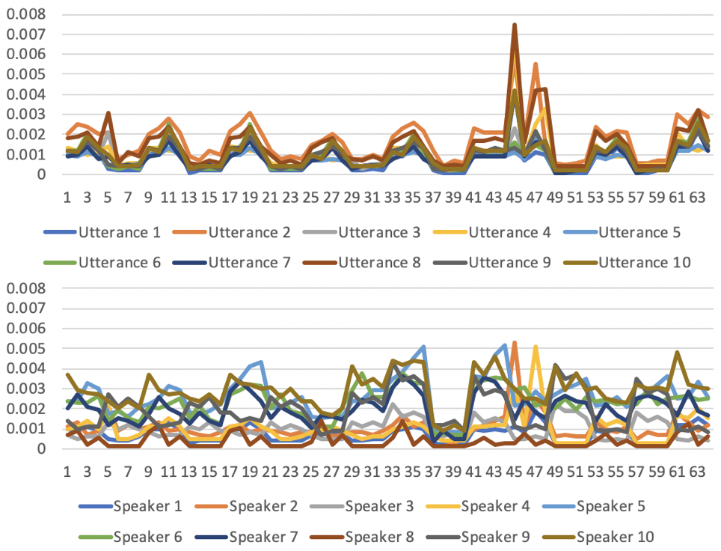
3.3 Experiment
Persistent memory analysis
Attention scores of ten utterances from one speaker is similar
Attention scores of ten utterances from ten speakers are different

Slide 26
4 Conclusions & Future work
Contribution 1:
An effective cross attention biasing method for monotonic alignment between text and speech
Contribution 2:
Speaker aware persistent memory model for speaker adaptation

Slide 27
4 Conclusions & Future work
Extension of contribution 1:
Integration with a more effective encoder network
Global misalignment regularization
Extension of contribution 2:
Speaker i-vector clustering
Include i-vector generation as a full end-to-end model
Speaker diarization
Replace i-vector with channel / background noise – environment identification / noise adaptation
Future work 3:
Robustness towards other factors (domain, language model, channel etc.)
Future work 4:
Unsupervised adaptation (speaker adaptation without i-vector)
Future work 5:
Multilingual ASR, use pretrained mBART model for decoder

Slide 28
Thank you very much!

